Slide 1

Healthy home academy
# Automatizace

Slide 2
// THE Indoor generation
Healthy home academy
Klára bukolská

Slide 3
Notes:
In many ways, a healthy indoor environment resembles the experience of
being outside on a mild summer's day. Moderate temperatures combined
With loads of fresh air and daylight is really the essence of comfort and well-being. By connecting to the natural sources that surround us, we recognise the bond that exists between comfort, health and sustainability.
Daylight and fresh air provide vital benefits
A healthy home uses daylight and fresh air to create optimal natural lighting,
adequate air humidity and minimal amounts of CO2, microdust particles and allergens. It employs simple and naturally-occurring strategies to maintain pleasant temperatures and lighting conditions throughout the day, and it
uses low-toxic building materials from the inside out. Thanks to these
properties, a healthy home is able to improve the physical and mental health of its residents – making them less susceptible to respiratory diseases,
improving their quality of sleep, and enhancing their ability to concentrate, learn and perform.
By utilising solar gain, natural ventilation and dynamic shading as natural
sources for heating and cooling, the energy profile of a healthy home is also
more sustainable.

Slide 4
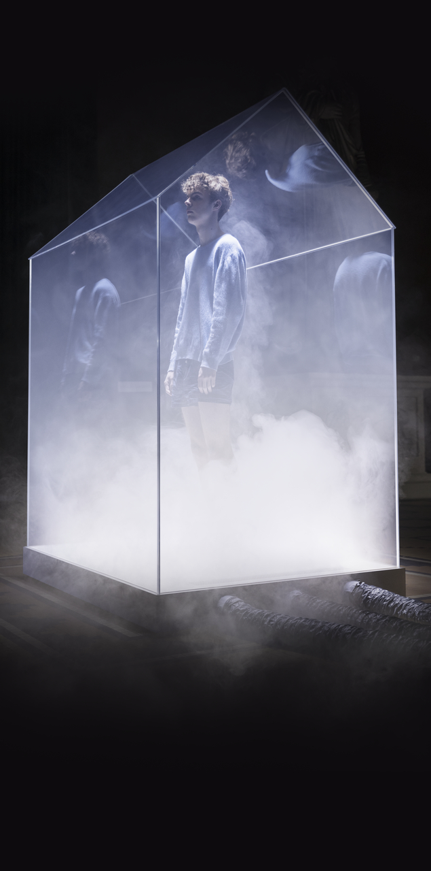

Co si myslíme …
The Indoor Generation

Slide 5
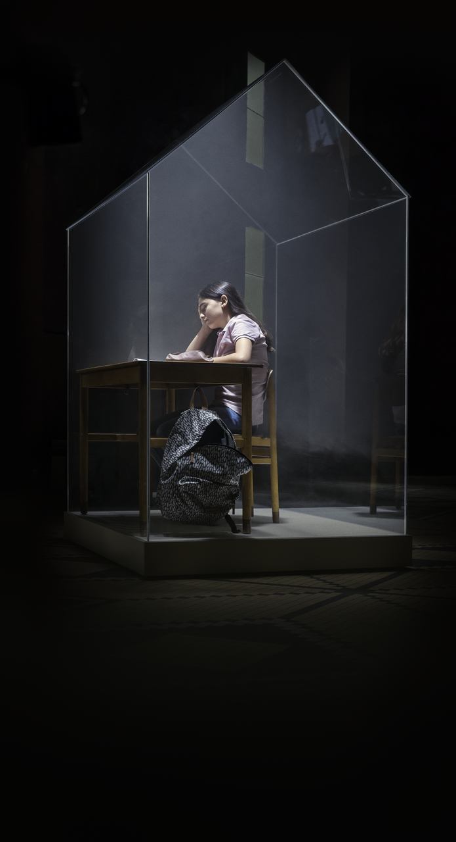
Co si myslíme …
The Indoor Generation

Slide 6
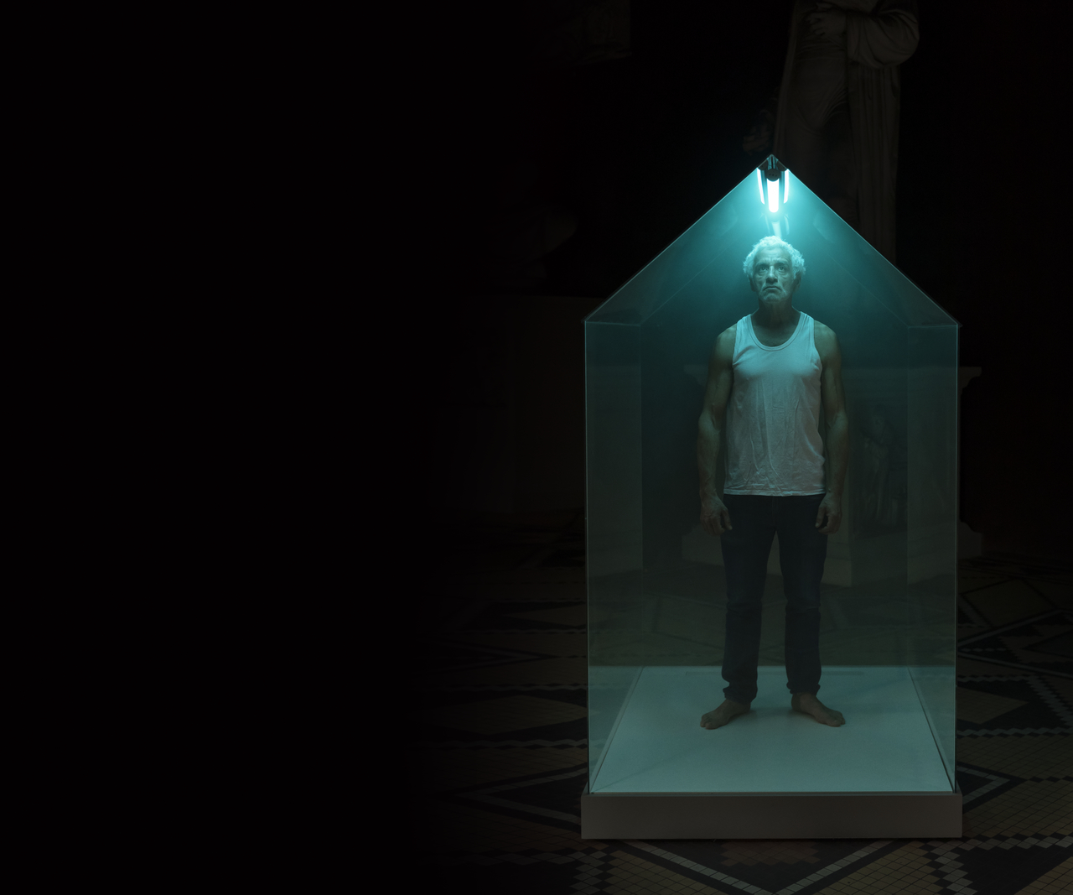
Co si myslíme …
JAK OVLIVŇUJE DENNÍ SVĚTLO VAŠI NÁLADU?
CELKEM
DÁNSKO
VELKÁ BRITÁNIE
USA
NĚMECKO
FRANCIE
BELGIE
ČESKÁ REPUBLIKA
NIZOZEMÍ SLOVENSKO
ITÁLIE
RAKOUSKO
ŠVÝCARSKO
KANADA
ŠPANĚLSKO
3 %
2 %
3 %
4 %
4 %
3 %
2 %
2 %
1 %
2 %
1 %
1 %
2 %
2 %
1 %
39 %
42 %
30 %
36 %
39 %
38 %
41 %
34 %
43 %
47 %
52 %
43 %
43 %
42 %
51 %
28 %
28 %
26 %
32 %
27 %
26 %
27 %
26 %
29 %
35 %
29 %
24 %
33 %
31 %
31 %
17 %
17 %
26 %
16 %
19 %
18 %
19 %
18 %
13 %
11 %
13 %
18 %
15 %
19 %
11 %
20 %
13 %
14 %
16 %
16 %
13 %
11 %
6 %
8 %
8 %
10 %
8 %
10 %
7 %
8 %
ŽÁDNÝ
MALÝ
ZANEDBATELNÝ
VELKÝ
NEVÍM
Všechna čísla jsou zaokrouhlena. Celková hodnota je uvedena s ohledem na počet obyvatel dané země.
NEDOSTATEK
SVĚTLA
u 15 %
Z NÁS ZPŮSOBUJE ŠPATNOU NÁLADU
The Indoor Generation

Slide 7


Co si myslíme …
JAK OVLIVŇUJE DENNÍ SVĚTLO VÁŠI PRODUKTIVITU?
CELKEM
DÁNSKO
VELKÁ BRITÁNIE
USA
NĚMECKO
FRANCIE
BELGIE
ČESKÁ REPUBLIKA
NIZOZEMÍ SLOVENSKO
ITÁLIE
RAKOUSKO
ŠVÝCARSKO
KANADA
ŠPANĚLSKO
4 %
5 %
6 %
5 %
5 %
7 %
4 %
3 %
1 %
3 %
2 %
2 %
3 %
3 %
3 %
32 %
30 %
20 %
34 %
29 %
25 %
31 %
31 %
35 %
42 %
41 %
31 %
29 %
37 %
35 %
29 %
O 6–12 %
30 %
34 %
26 %
38 %
32 %
31 %
28 %
33 %
37 %
38 %
28 %
35 %
26 %
33 %
31 %
VZROSTLA
17 %
21 %
14 %
23 %
18 %
17 %
19 %
14 %
20 %
17 %
17 %
VÝKONNOST ZAMĚSTNANCŮ CALL CENTRA
21 %
21 %
15 %
21 %
DÍKY LEPŠÍMU VÝHLEDU A MNOŽSTVÍ
16 %
10 %
19 %
21 %
8 %
12 %
16 %
12 %
8 %
12 %
8 %
10 %
16 %
10 %
DENNÍHO SVĚTLA
ŽÁDNÝ
MALÝ
ZANEDBATELNÝ
VELKÝ
NEVÍM
Všechna čísla jsou zaokrouhlena. Celková hodnota je uvedena s ohledem na počet obyvatel dané země.
The Indoor Generation

Slide 8


archetypy
Notes:
Herbert Bangs: Návrat posvátné architektury
Čtyři základní archetypy – jeskyně, mýtina, zahrada a voda.
Jeskyně – archetypální obraz přístřeší. Otvor vedoucí do země. Té země, která byla vždy považována za Matku. Matka je zdrojem potravy, dárcem života a místem, kam se vždy všichni navracíme (Freud). Pokud člověk tento obraz opomine, nebo ignoruje, povede to k pocitu nejistoty a neustále nespokojenosti s naším bytím.
Mýtina – prostor otevřený obloze, po němž se můžeme volně pohybovat a pozorovat okolí. Mýtina znamená světlo a vzduch a je tedy protipólem jeskyně. Zatímco jeskyně je jak základním a nejbližším archetypálním projevem feminina, neboli matky, mýtina je archetypálním projevem maskulinního hlediska našeho bytí. Oba dva jsou pro nás z psychologického hlediska nezbytné a oba sahají daleko do roviny poznání, které vyjadřuje zkušenost lidského druhu.

Slide 9
Navrhujeme domy pro „INDOOR GENERATION“
Notes:
Buildings are powerful. Designed in the right way, they are able to brighten our minds and relax our bodies. They provide us with a place to rest,
Recharge and recover in a busy life. This is good news for a generation that has grown accustomed to spending more than 90% of its time inside buildings.
Still, forming an era where the search for ways to optimise our health has
become a defining trait, this indoor generation is only just realising how the
home can help to invigorate our lives. Considering the results of scientific
studies, it is becoming increasingly obvious that an optimal building design
is capable of much more than keeping our heads dry. It also has the ability
To improve the way we sleep and increase our intellectual performance. It
even has the capability to prevent headaches and long-term health issues like asthma and allergies.
To support these abilities, we have created a handbook to give you the facts regarding indoor environments and a set of design recommendations to help you fulfil your architectural vision. With this on your desk, you are much closer to releasing the healing power of the home and much less susceptible
to leave a traceable impact on the environment.
Based on the Active House principles, the Model Home 2020 programme
and numerous scientific studies accumulated by expert teams from the
VELUX Group, the content of this handbook constitutes our contribution to
promoting healthy homes. Our aim is to describe how daylight, thermal
comfort and indoor air quality can enhance indoor comfort and improve
the health of a home's inhabitants.

Slide 10
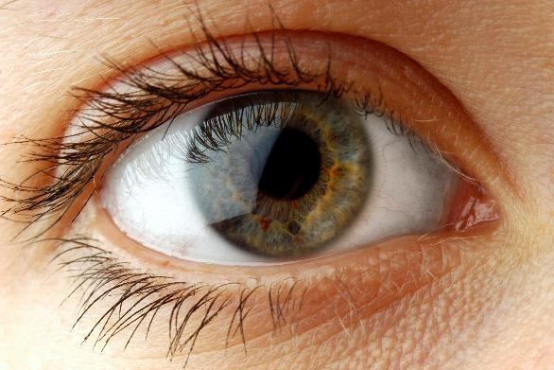





Denní světlo nás ovlivňuje
vitamín D
biologické hodiny jsou řízeny denním světlem
více jak 30 % Evropanů trpí zimními depresemi
Produkce kortizolu a melantoninu
Denní světlo může zvýšit výkon až o 15 %
Notes:
Most people recognize that daylight plays an essential role in their lives, but
how does it actually contribute to our health?
Let’s start with our mental abilities. In a study from 2002, companies recorded a 15% increase in productivity when employees were moved to buildings with better daylight (Edwards and Torcellini, 2002). Another study,
also from 2002, revealed that students in classrooms with the most window
area or daylighting produced 7% to 18% higher scores on standardised tests than those with the least window area or daylight (Heschong, 2002).
Biology is affecting our mood The two studies express a common theme, which is apparent in all similar work, namely that daylight increases our
mental aptitudes and even heightens our moods. Experts estimate that up to 30% of the world’s population suffer from different levels of Seasonal Affective Disorder (SAD), caused by lack of lighting. Regarding the indoor generation, the condition, which is commonly known as winter depression, could very well be a sign of the times. It is a well-known fact, however, that light therapy and exposure to daylight above 1000 lux can act as cure for
SAD.
To understand the biological effects of daylight, it should be noted that
the human eye has a specific sensory system that is not related to vision.
Instead it uses daylight to help regulate the secretion of hormones and
neurotransmitters in the brain. The process involves regulation of cortisol,
which is related to stress, and melatonin, which is seen as a prerequisite to sleep. Living in poorly-lit environments limits this process and weakens the
individual’s mental capacity.
The D factor
Vitamin D synthesis requires light exposure around 300 nm in the UV range.
Reduced levels of vitamin D have been linked to increased vulnerability to
Both developmental and somatic diseases in adults.
The master clock runs on light
The human body has a built-in biological master clock, which is deeply
Dependent on visual input, mainly daylight. During nighttime, the clock sets the body in a relaxed state-lowering the metabolism, increasing the production of growth hormones and rinsing the brain of toxins. To keep the clock working, the indoor environment needs to be in direct contact with the circadian rhythm, i.e. the natural light levels of day and night.
The biological clock is genetic
In 2017, the Nobel Prize in Physiology and Medicine was awarded to a group
of scientists that discovered how the biological clock works as a self-sustaining process on a cellular level. Their findings documented that certain genes help accumulate and degrade a protein in a way that corresponds to the circadian rhythm. This knowledge supports the fact that every living
organism is bound to a day-and-night rhythm, which cannot be changed by will or external factors.

Slide 11
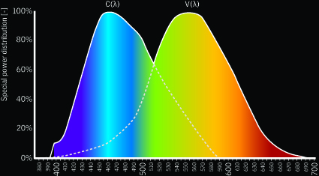

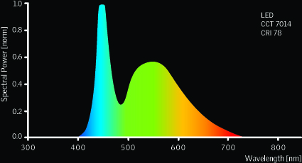
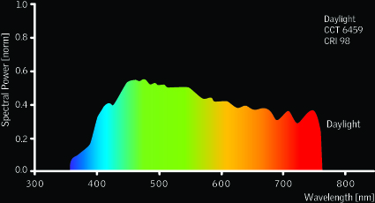
Denní světlo nás ovlivňuje
24H CIRKADIÁNNÍ RYTMUS
OVLIVŇUJE SPÁNEK, PŘÍJEM POTRAVY, KREVNÍ TLAK A TĚLESNOU TEPLOTU
VYSOKÁ OSTRAŽITOST
NEJLEPŠÍ KOORDINACE
12
RYCHLÝ NÁRŮST KREVNÍHO TLAKU
NEJRYCHLEJŠÍ REAKCE
UVOLŇOVÁNÍ KORTISOLU
6
18
NEJVYŠŠÍ TĚLESNÁ TEPLOTA
NEJNIŽŠÍ TĚLESNÁ TEPLOTA
NEJVYŠŠÍ KREVNÍ TLAK
24
HLUBOKÝ SPÁNEK
UVOLŇOVÁNÍ MELATONINU
biologické hodiny jsou řízeny denním světlem

Slide 12

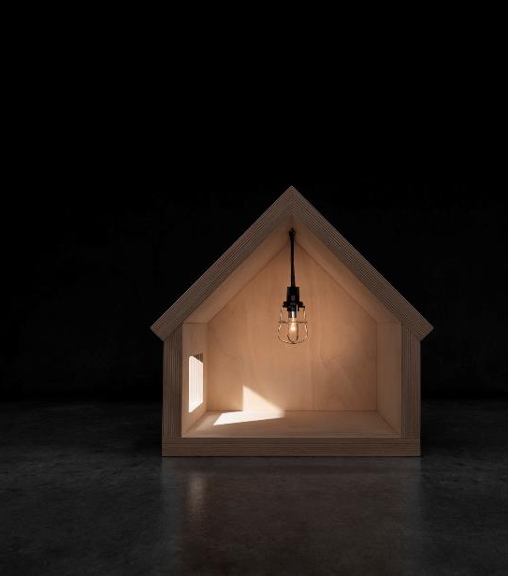
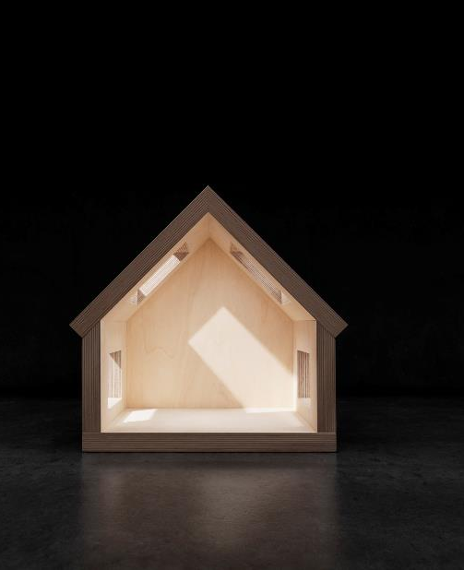
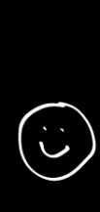


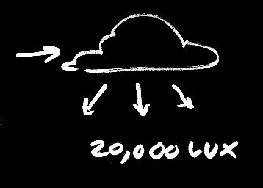
KOLIK SVĚTLA JE DOST?
Notes:
Compared to artificial lighting, daylight has the highest levels of light needed to support biological functions (Hathaway et al., 1992). The light, which is important to our circadian rhythm (C(λ)), is different from the light that we use to orientate ourselves visually (V(λ)). The difference is due to the spectral difference in the light sensitivity of the individual photoreceptors (spectrum).
No electric light sources have been made that mimic the variation in the light spectrum that occurs with daylight (Boyce et al., 2003).
From above, figures show the circadian and visual system’s response to the spectral composition of LED lighting and daylight. The circadian system (C(λ)) is most affected by the wavelength region 446 to 488 nm, whereas the visual system (V(λ)) is most affected by the wavelength around 555 nm. The spectral composition of daylight reveals that daylight is in the regions of circadian response, and furthermore, it is bright at the times of day that seem most important to these processes, as well as daylight is much more energy-efficient delivering the needed light levels, compared to typical electric light sources.
Grafic 1: Some electric lighting is able to imitate a limited range of the light spectrum, but none cover the entire spectrum or provide variations like daylight.
Grafic 2: The light spectrum changes during the day, e.g. rich blue around midday to warmer yellow and red tones in the evening. Experiencing these, variations is essential to our circadian rhythm.

Slide 13
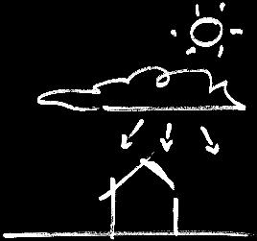
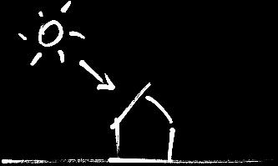

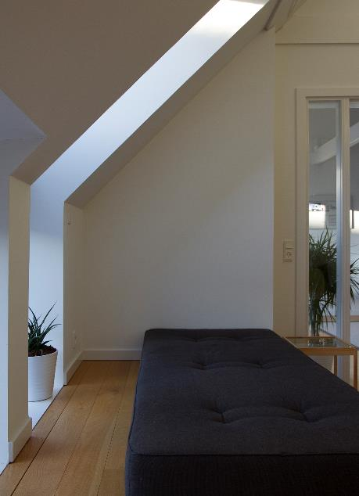
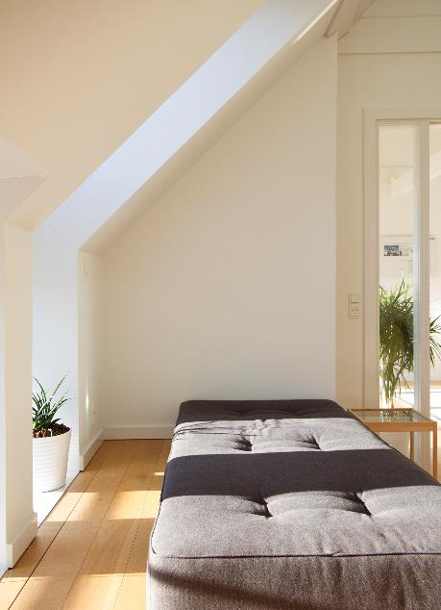
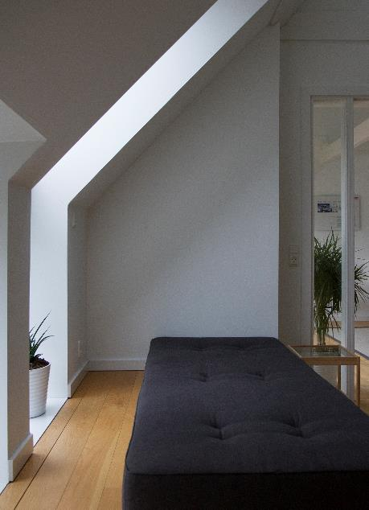
Denní světlo nikdy není „normální“
Soltag, 10:15, December (clear sky)
Soltag, 12:00, December (clear sky)
Soltag, 15:30, December (cloudy)
Notes:
When you experience daylight, it is always a certain kind of daylight. A dawn painted in red, a reflected overcast sky or a December sun, hanging low on the horizon. They all bring a different lighting quality to the home and make the placement and distribution of windows essential.
In this section we examine the properties of daylighting and present an array of architectural archetypes that reveal how opening the home to the outside changes the perception of living indoors.

Slide 14
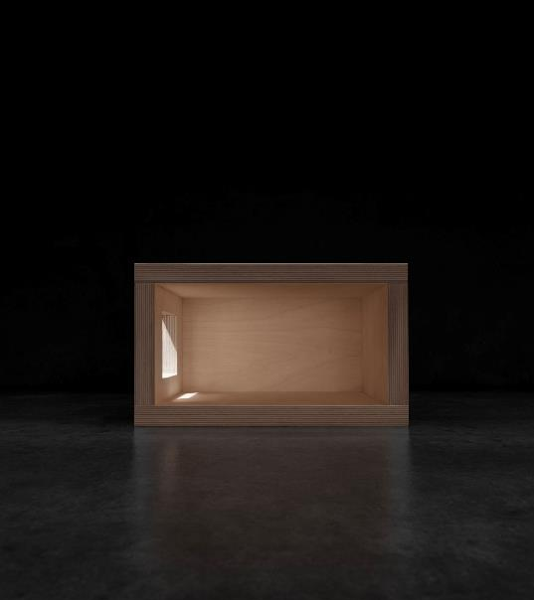
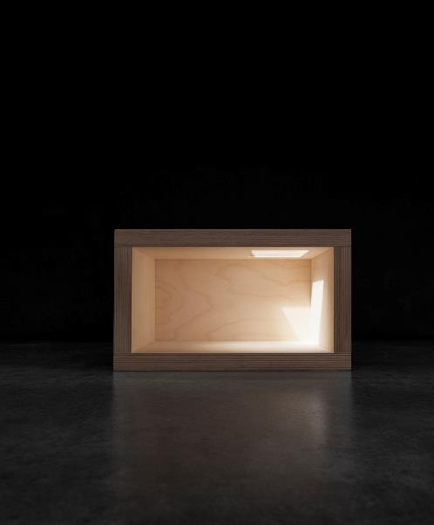
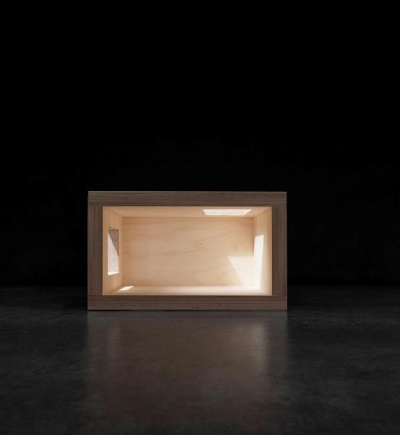
Hluboké místnosti
Notes:
Since daylight from the side only delivers a fraction of what is available, one-storey buildings with flat roofs and deep rooms often struggle to bring natural lighting into every corner. Openings in the roof will distribute more daylight into central rooms and other darkened areas.
Three times more intense Daylight
Depending on size, number and placement, roof-lights add twice the amount of daylight to rooms in buildings with pitched roofs and three times more in flat-roofed homes compared to façade windows.
In contact with nature
While openings in the facade connect us to the surrounding landscape, roof openings connect us to the sky. There might not be much to look at, but our bodies react to the sensation. Contact with the outside living environment, regardless of concrete scenic content, is an important psychological aspect linked to daylighting (Robbins, 1986). Windows supply information of orientation, give experience of weather changes and allow us to follow the passage of time throughout the day.
Grafic 1: Even fairly large facade windows provide on average a limited amount of lighting as well as very unbalanced daylight conditions.
Grafic 2: A horizontal opening through the roof provides intense daylighting
in central or deep areas.
Grafic 3: Combining the two openings creates a diversified lighting environment with variations in daylight intensity, a greater perception of space and more viewing options.

Slide 15
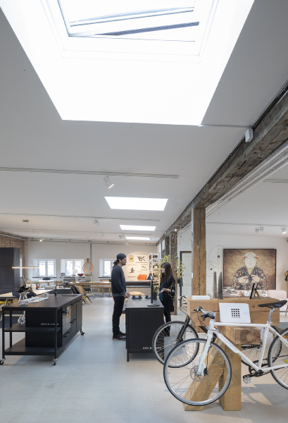
Notes:
Since daylight from the side only delivers a fraction of what is available, one-storey buildings with flat roofs and deep rooms often struggle to bring natural lighting into every corner. Openings in the roof will distribute more daylight into central rooms and other darkened areas.
Three times more intense Daylight
Depending on size, number and placement, roof-lights add twice the amount of daylight to rooms in buildings with pitched roofs and three times more in flat-roofed homes compared to façade windows.
In contact with nature
While openings in the facade connect us to the surrounding landscape, roof openings connect us to the sky. There might not be much to look at, but our bodies react to the sensation. Contact with the outside living environment, regardless of concrete scenic content, is an important psychological aspect linked to daylighting (Robbins, 1986). Windows supply information of orientation, give experience of weather changes and allow us to follow the passage of time throughout the day.
Grafic 1: Even fairly large facade windows provide on average a limited amount of lighting as well as very unbalanced daylight conditions.
Grafic 2: A horizontal opening through the roof provides intense daylighting
in central or deep areas.
Grafic 3: Combining the two openings creates a diversified lighting environment with variations in daylight intensity, a greater perception of space and more viewing options.

Slide 16
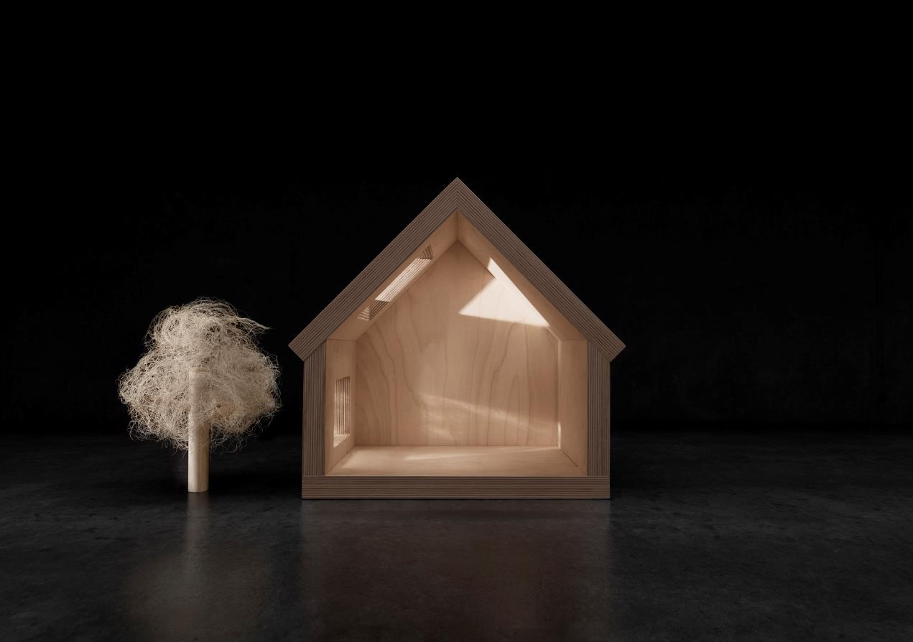
SVĚTO MÁ VSTUPOVAT DO MÍSTNOSTI Z VÍCE SVĚTOVÝCH STRAN
ORIENTATION
Notes:
The challenge of daylight
While good daylight design provides large amounts of natural lighting, it is also something that should be implemented with a certain amount of care. Our daily life consists of changing visual tasks, with similarly-changing lighting demands. Light variations can influence visual comfort and performance, which means that good visibility demands some degree of uniformity of light.
The dynamic character of the daylight influx calls for a number of measures to control or lessen the natural variations during the day. This is especially relevant in rooms like the kitchen and bathroom, where a functional working environment is required. However, daylight should be managed in a way that keeps the circadian rhythm in view and supports the resident’s ability to nurture their biological clock.
Grafic: As the sun travels across the sky, the level of direct lighting may exceed functional demands. Placing the roof windows opposite or adjacent
to white walls converts direct light into reflected lighting, producing softer and more pleasant lighting conditions.

Slide 17
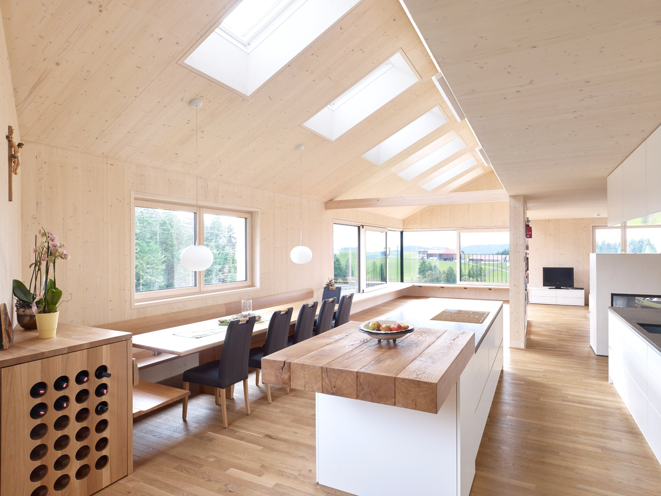
Notes:
Since daylight from the side only delivers a fraction of what is available, one-storey buildings with flat roofs and deep rooms often struggle to bring natural lighting into every corner. Openings in the roof will distribute more daylight into central rooms and other darkened areas.
Three times more intense Daylight
Depending on size, number and placement, roof-lights add twice the amount of daylight to rooms in buildings with pitched roofs and three times more in flat-roofed homes compared to façade windows.
In contact with nature
While openings in the facade connect us to the surrounding landscape, roof openings connect us to the sky. There might not be much to look at, but our bodies react to the sensation. Contact with the outside living environment, regardless of concrete scenic content, is an important psychological aspect linked to daylighting (Robbins, 1986). Windows supply information of orientation, give experience of weather changes and allow us to follow the passage of time throughout the day.
Grafic 1: Even fairly large facade windows provide on average a limited amount of lighting as well as very unbalanced daylight conditions.
Grafic 2: A horizontal opening through the roof provides intense daylighting
in central or deep areas.
Grafic 3: Combining the two openings creates a diversified lighting environment with variations in daylight intensity, a greater perception of space and more viewing options.

Slide 18
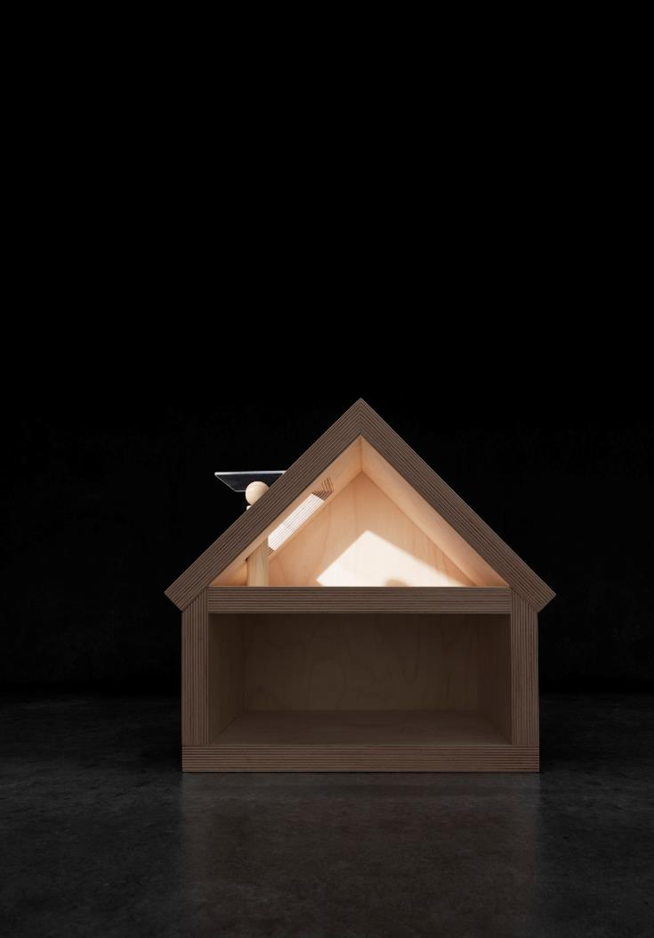
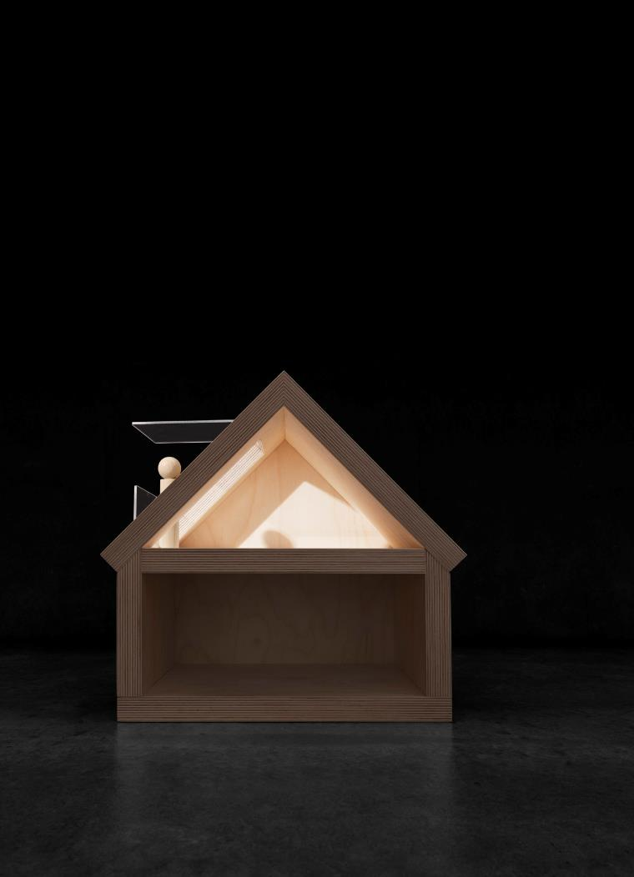
Notes:
Expand the home indefinitely
Opening up the home to the surroundings is one of the most common features within today’s new build and renovation projects. The effect is desirable for obvious reasons, although it also builds on proven psychological affinities. As stated earlier, the provision of daylight alone is not enough to satisfy user desires for views. Windows provide contact with the outside, supply information on orientation, give notification of weather changes and allow us to follow the passage of time over the day.
The visual effect of a view is sometimes subtle, but never to be missed. A view expands the interior, creating a sense of space and roominess that continues all the way to the horizon. A great view draws nature into the home and vice versa, thereby establishing a very tangible and mentally pleasing connection to an environment, which we per instinct conceive as more fresh and healthier.
The anti-stress building design
Studies on the effects of visual cues on stress-related symptoms suggest that viewing natural sceneries may help to reduce blood pressure, heart activity and muscle tension much faster than viewing urban landscapes (Ulrich, 2008). Similar experiments show that up to one in five employees in office
buildings registers fewer symptoms related to Sick Building Syndrome compared to their colleagues, when placed close to windows with views (Fairly et.al., 2001).
1+1=much more
When a single roof window is combined with a roof window of similar size, the actual increase in illumination is more than doubled. The effect is due to the fact that combined windows have a larger pane-to-lining ratio and thus less obstruction of daylight influx.
Grafics:
Expand the home outwards by creating a viewing area with bottom-operated
roof windows that allow residents to stand underneath the open windowpane. Supplement with extra vertical or sloped elements to create a floor-to-ceiling experience.
An outdoor balcony can be created without major structural changes to the
roof. The VELUX CABRIO® establishes a true link between the interior and a private outdoor area and features an integrated glass and metal railing.

Slide 19
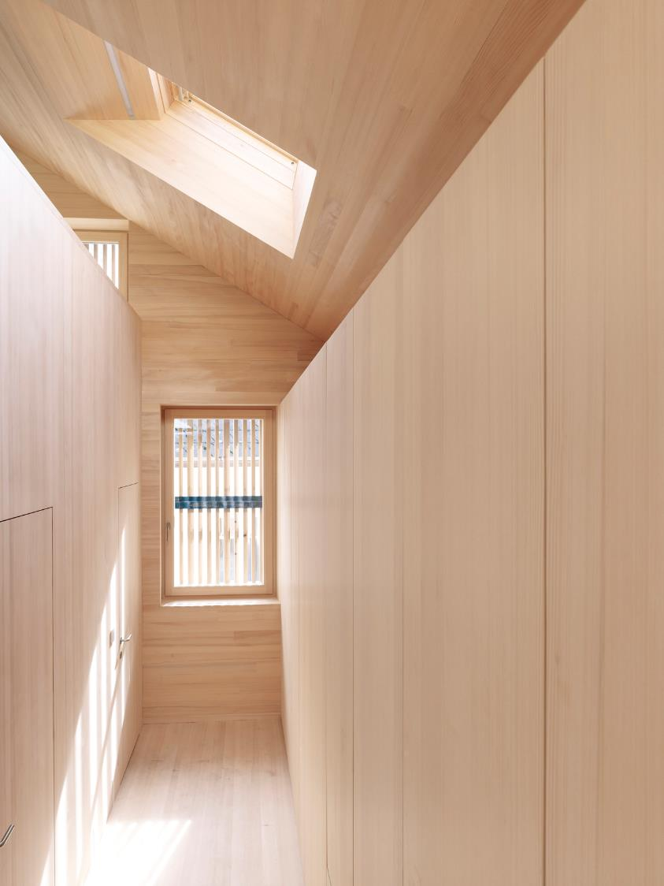
Notes:
Since daylight from the side only delivers a fraction of what is available, one-storey buildings with flat roofs and deep rooms often struggle to bring natural lighting into every corner. Openings in the roof will distribute more daylight into central rooms and other darkened areas.
Three times more intense Daylight
Depending on size, number and placement, roof-lights add twice the amount of daylight to rooms in buildings with pitched roofs and three times more in flat-roofed homes compared to façade windows.
In contact with nature
While openings in the facade connect us to the surrounding landscape, roof openings connect us to the sky. There might not be much to look at, but our bodies react to the sensation. Contact with the outside living environment, regardless of concrete scenic content, is an important psychological aspect linked to daylighting (Robbins, 1986). Windows supply information of orientation, give experience of weather changes and allow us to follow the passage of time throughout the day.
Grafic 1: Even fairly large facade windows provide on average a limited amount of lighting as well as very unbalanced daylight conditions.
Grafic 2: A horizontal opening through the roof provides intense daylighting
in central or deep areas.
Grafic 3: Combining the two openings creates a diversified lighting environment with variations in daylight intensity, a greater perception of space and more viewing options.

Slide 20
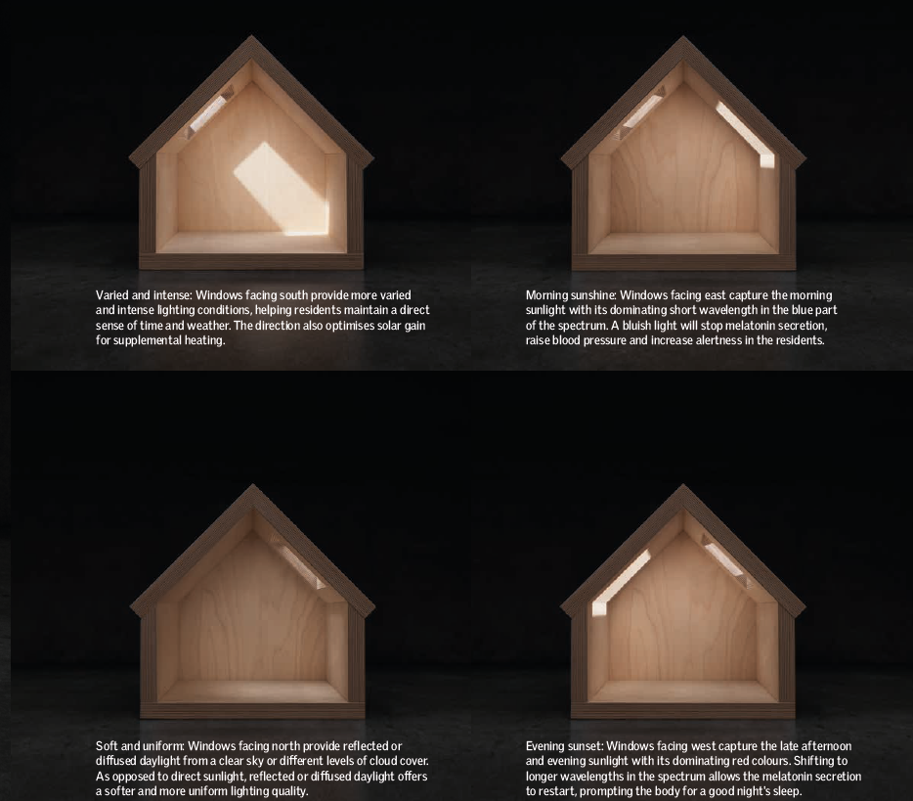
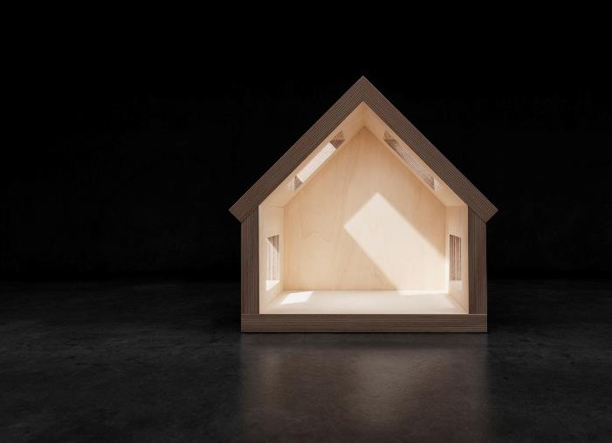
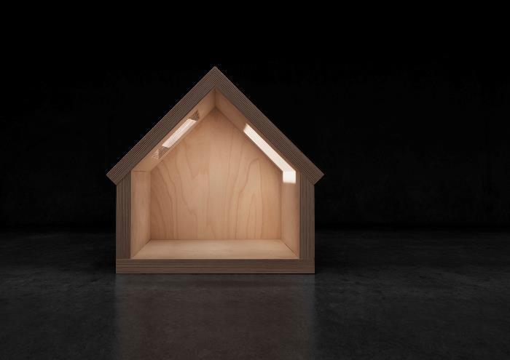
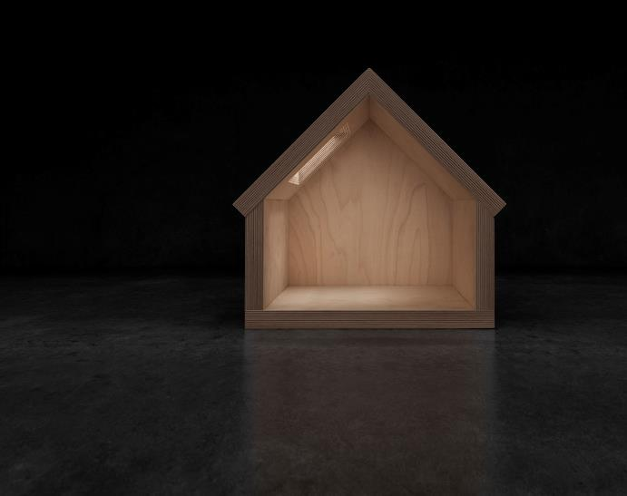
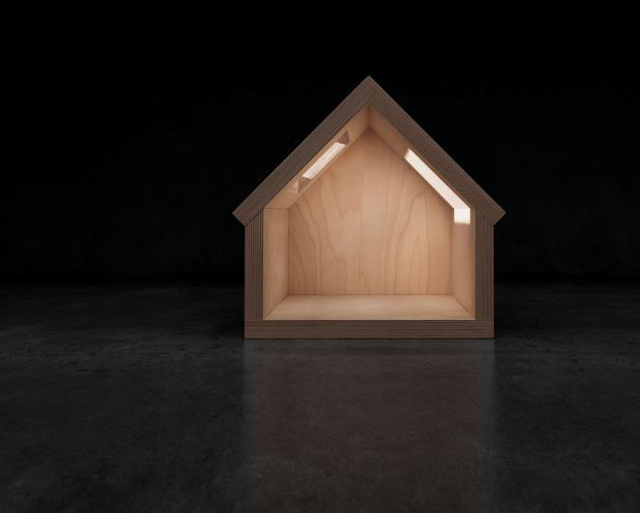
ATMOSFÉRA OVLIVNĚNÁ ROZMÍSTĚNÍM OKEN
ORIENTATION
Notes:
Daylight is all about the where and when
Latitude and orientation are determining factors in terms of how daylight will affect the indoor environment.
The latitude affects solar elevation and becomes an increasingly influential variable as the site of the building is moved further away from the equator.
The orientation of the building and its windows influence the availability and
qualities of daylight in the interior. In the northern hemisphere, light coming
from the north is mainly composed of diffuse sky light and provides the interior with a functional and comfortable light. Light from the south, east and west mainly offers direct sunlight and light levels that vary significantly throughout the day.
Stronger and softer
Roof windows provide at least twice as much light as vertical windows and three times more light than dormers of the same size. Roof windows are shown to give higher wall luminance than dormer and facade windows, resulting in less glare due to a softer transition between pane and wall.
Glare leaves details in the dark
Glare occurs when luminance variations exceed 20:1 to 40:1 (Rea, 2000). The eye will adapt to the high level of the glare source, making it hard to perceive details in the now too-dark room.
Grafics:
Varied and intense: Windows facing south provide more varied and intense lighting conditions, helping residents maintain a direct sense of time and weather. The direction also optimises solar gain for supplemental heating.
Morning sunshine: Windows facing east capture the morning sunlight with its dominating short wavelength in the blue part of the spectrum. A bluish light will stop melatonin secretion, raise blood pressure and increase alertness in the residents.
Soft and uniform: Windows facing north provide reflected or diffused daylight from a clear sky or different levels of cloud cover. As opposed to direct sunlight, reflected or diffused daylight offers a softer and more uniform lighting quality.
Evening sunset: Windows facing west capture the late afternoon and evening sunlight with its dominating red colours. Shifting to longer wavelengths in the spectrum allows the melatonin secretion to restart, prompting the body for a good night's sleep.

Slide 21
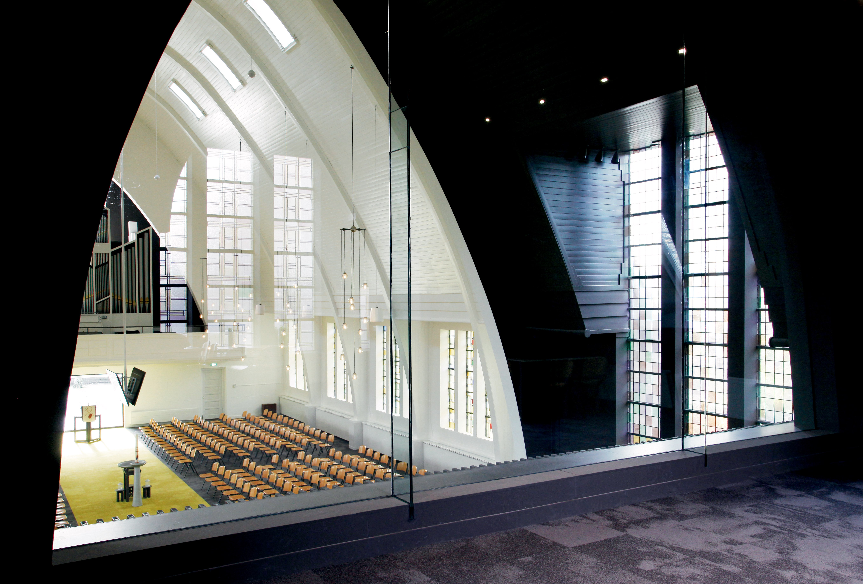

JULIANA FAMILIA

Slide 22
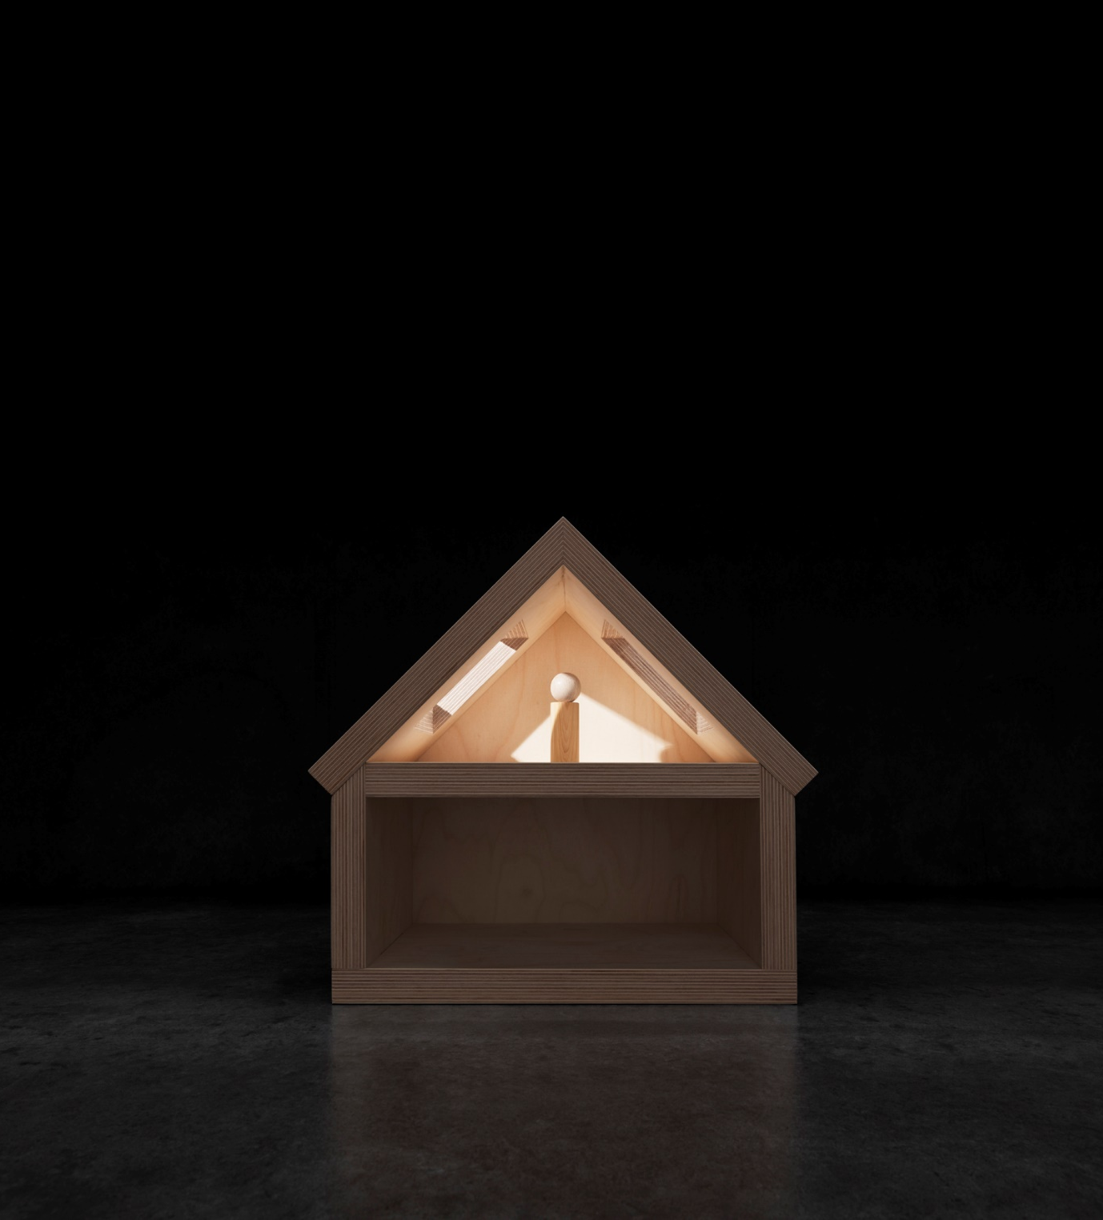
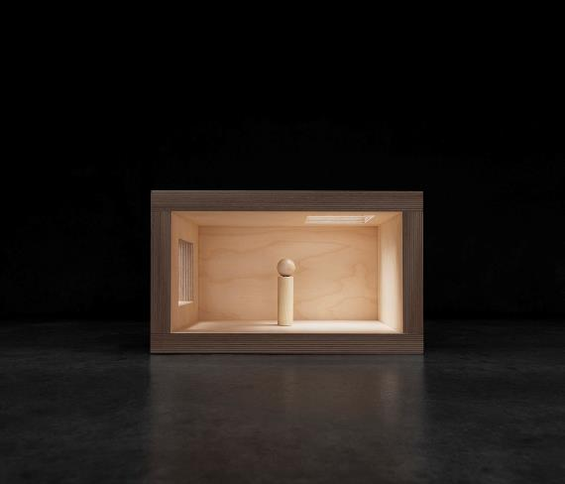



Pohled ven mění pocit uvnitř
Notes:
When you open the interior to the sky and surrounding landscape, the perception of the room is altered entirely. Instead of having a boxed interior, the inside suddenly becomes a doorway to the outside – a place where plenty of daylight, space and a connection to nature define the experience.
Research likes a good view
A wide array of studies underline the effects of maintaining a visual link to th outdoor environment. A view with layers of sky, city or landscape, and ground could counteract tiring monotony and help relieve the feeling of being closed in (Boyce et al., 2003).
A view to nature may have a positive influence on people’s sense of well being (Kaplan, 2001), better subjective health (Kaplan, 1993), higher environmental satisfaction (Newsham et al., 2009), better mood (Grinde and Grindal Patil, 2009), reduced health problems (Heschong Mahone Group, 2003), job satisfaction, recovery of surgical patients (Ulrich, 1984) and stressfull experiences (Ulrich et al., 1991), and seating preference (Wang and Boubekri, 2010, 2011).
A feeling of spaciousness
Flat-roofed buildings often have ceilings with a relatively large number of square meters. With limited access to daylight, the interior in many cases adopts a cave-like appearance, creating large patches of unlit and gloomy surfaces. Opening the ceiling will interrupt the monotonous structure with bright wells of daylight and create a new sense of space deep within the building.
Grafic 1: Facade windows give residents a sense of location and local events. Flat roof windows provide a sense of space and connection to the circadian rhythm.
Grafic 2: Pitched roof windows expand the visual experience to incorporate the surrounding landscape as well as daily variations in the sky.

Slide 23
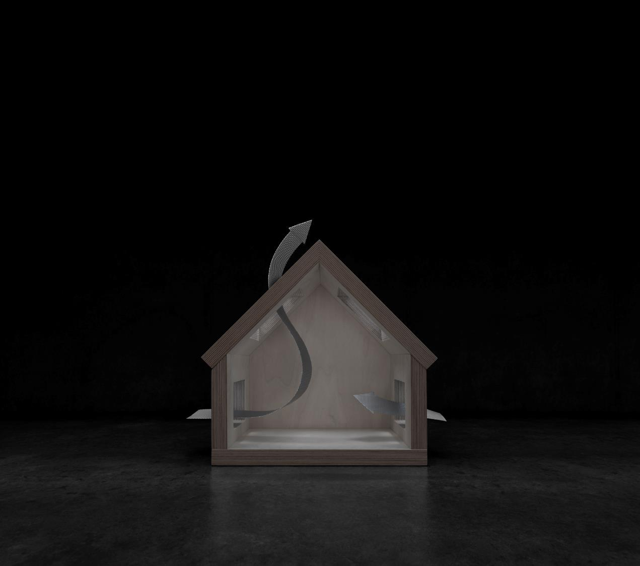
ZDRAVÉ SVĚTLO
ZDRAVÁ TMA
Notes:
Sound asleep
It can be quite a challenge to keep all the necessary requirements for an ideal sleeping environment in balance all year round. Lighting, air quality and energy consumption all need to be controlled to ensure the best possible conditions in the bedroom. The following are three ways of tackling the different issues related to controlling the environment summer and winter.
Grafic: Night cooling uses cool outdoor air to cool down a building’s thermal
mass. The next day less cooling is needed to cool the building, as the thermal mass has already been cooled down.

Slide 24



Kvalita vnitřního vzduchu
Ventilace je klíčem k čerstvému vzduchu
Když jsme v místnosti, necítíme, že se vzduch zhoršuje
S érou částečných renovací jsme přišli o mikroventilaci netěsnosttí
Notes:
With people spending about 90% of their time inside buildings, it is almost
certain that high amounts of CO2, moisture and particles are part of
everyone’s daily air intake. The indoorlevels of some pollutants are often 2.5-5 times higher than outdoor levels, and as we all breathe approx. 22,000
times a day, it becomes difficult to avoid whatever airborne elements the
building is going to throw at us.
Insufficient airing damagesour health
And we know it is happening. According to the German research organization Fraunhofer IBP, 80 million Europeans live in damp and unhealthy buildings. Furthermore, the Healthy Homes Barometer 2016 reveals that almost every other person doesn’t prioritise low air humidity and almost six out of 10 do not air out sufficiently. There are a number of reasons why that is untenable in the long run. While high levels of CO2 create dizziness and headaches, damp and mouldy environments can increase the risk of developing asthma by 40% and weaken our mental aptitudes. High humidity can also provoke respiratory problems and allergic reactions. Micro particles, chemical particles and indigenous gasses like radon can lead to severe health problems. The only way to deal with these issues is to replace the exhaust air with fresh air – in other words, to ventilate.
Natural ventilation isn’t just hot air
Natural ventilation uses natural forces like temperature differences to replace air in the building. Fresh air is supplied via open windows, doors, fresh air grilles or ventilation flaps. Exhaust air is removed when used and warm air rises upwards through high-placed openings or when wind currents are deliberately established between several openings, e.g. as cross ventilation or the stack effect. For a detailed description of airing methods go to the “Ventilation” chapter.
We do not sense when something is wrong
Some air pollutants are easier to detect than others. When the amount of CO2 increases, so does the emission of volatile organic compounds (VOCs). The odour, which is a common side effect of the emission, makes CO2 detectable above 1500 ppm, We also register humidity levels when they exceed 80% or go below 30%. Detecting certain pollutants like radon, formaldehyde (glue), dust and particles from electric appliances is far more difficult. Thus, frequent airing is recommended, even if the environment seems dry and odourless.
Years lost to bad air quality
A European group of experts* have estimated that two million health-years
of living are lost every year in the 26 EU countries (participating in the study) due to pollution of the indoor air. Loss of health-years are defined as years lost due to early death or years afflicted by severe illness. This equals about 3% of the total burden of disease due to all diseases from all causes in Europe.
* Jantunen M., Oliveira Fernandes E., Carrer P.,
Kephalopoulos S. (2011). Promoting actions for
healthy indoor air (IAIAQ). European Commission.
Directorate General for Health and Consumers.
Luxembourg

Slide 25
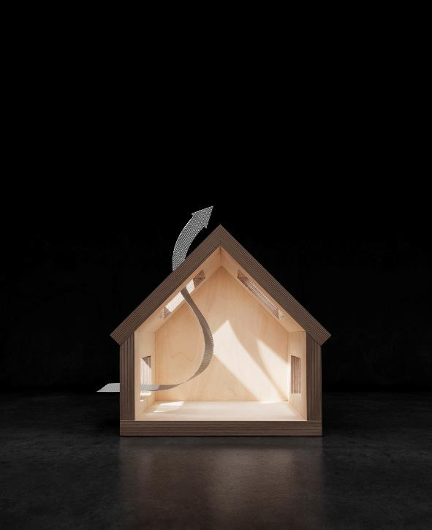

Kvalita vnitřního vzduchu
Notes:
Ventilation systems can be natural, mechanical or a combination of both, also known as hybrid systems. While mechanical ventilation carries a range of benefits in terms of heat recovery and air control, natural ventilation in itself remains a strong and free asset, if the building design allows for it to work properly. Two specific design elements should be highlighted when talking about the power of natural ventilation: cross-ventilation and airing by stack effect.
Airing with cross-ventilation
Air will enter the building at the windward side and leave through openings at the leeward side. Since the wind pressure is higher on the windward side than on the leeward side, the building will act as a funnel and accelerate the air, passing from one opening to the other. The shape of the building as well as the surrounding landscape or buildings affect the airflow. Optimal airflow relies on window placement and the residents ability to maintain the required level of ventilation via frequent operation. Typical values can be found in standards (e.g. BS5925:1991, DIN19466: 2009)
Airing with stack effect
Because warm air is lighter than cold air, warm air inside a building will rise and leave the building at the top through leakages, stack ducts or open windows. The air is replaced by cold air entering the building at ground level. A higher building will bring more power to the stack effect. For the stack effect to work efficiently, there must be air passages through the building. These can be stairways in combination with openings at both ground level and roof level. A proper stack effect will replace the used indoor air with fresh and clean outside air within minutes.
Grafic 1: Cross-ventilation uses two or more open windows opposite each other to ventilate the room, exploiting different air pressure zones on both sides of the building to create a self-supporting air current.
Grafic 3: Natural ventilation with stack effect uses high-placed openings in
combination with lower-placed openings, e.g. on the ground floor, to increase the buoyant warm air properties and flush the indoor environment within minutes.

Slide 26


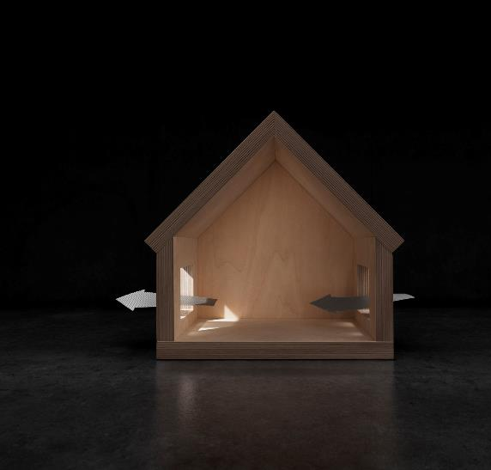

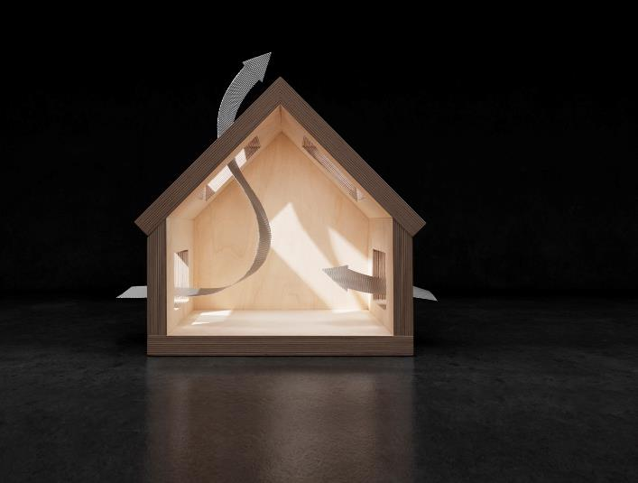

Přirozená ventilace
Notes:
Ventilation strategies
Rather than just opening a window and hoping for the best, it helps to know how different ventilation strategies are able to match the changing needs for air replacement. These four strategies represent a range of methods to ensure anything from gentle background ventilation to powerful airing.
0.5 ACH is the limit
Northern European building legislation´typically requires a ventilation ratio of 0.5 ACH. The risk of dampness-related illnesses such as asthma and allergies increases rapidly when the ACH drops below this threshold.
Easy airing
An automated system makes it easy to combine different strategies relative to season and time of the day. A home should be aired 2-4 times per day. Short interval airings prevent unwanted heat loss during the cold season. Extended airings help to cool down the building mass in the warm season.
Grafics:
Background ventilation: Background ventilation with ventilation valves and flaps ensures continuous air replacement without perceptible draught (approx. 0.5 ACH). Only recommended during the summer and transition seasons.
Stack effect: Stack effect draws on the natural buoyancy of warm air, pulling fresh cooler air in from the lower levels, while warmer exhaust air is flushed through open windows in the roof (approx. 4,5-6.0 ACH).
Cross ventilation: Cross ventilation utilises the difference in wind pressure on either side of the roof to generate an air current from one opening to the other (approx. 2.5-5.0 ACH).
Max airing: Stack effect with cross ventilation combines the two most efficient ventilation strategies. The combination can be applied to accelerate air replacement when needed, e.g. following social gatherings or after returning home after a long holiday.

Slide 27
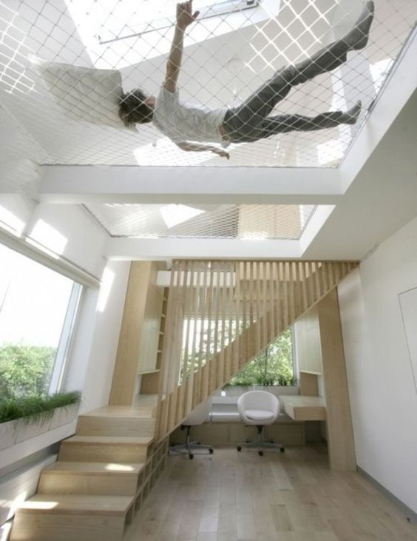
Větrání komínovým efektem
Notes:
Ventilation systems can be natural, mechanical or a combination of both, also known as hybrid systems. While mechanical ventilation carries a range of benefits in terms of heat recovery and air control, natural ventilation in itself remains a strong and free asset, if the building design allows for it to work properly. Two specific design elements should be highlighted when talking about the power of natural ventilation: cross-ventilation and airing by stack effect.
Airing with cross-ventilation
Air will enter the building at the windward side and leave through openings at the leeward side. Since the wind pressure is higher on the windward side than on the leeward side, the building will act as a funnel and accelerate the air, passing from one opening to the other. The shape of the building as well as the surrounding landscape or buildings affect the airflow. Optimal airflow relies on window placement and the residents ability to maintain the required level of ventilation via frequent operation. Typical values can be found in standards (e.g. BS5925:1991, DIN19466: 2009)
Airing with stack effect
Because warm air is lighter than cold air, warm air inside a building will rise and leave the building at the top through leakages, stack ducts or open windows. The air is replaced by cold air entering the building at ground level. A higher building will bring more power to the stack effect. For the stack effect to work efficiently, there must be air passages through the building. These can be stairways in combination with openings at both ground level and roof level. A proper stack effect will replace the used indoor air with fresh and clean outside air within minutes.
Grafic 1: Cross-ventilation uses two or more open windows opposite each other to ventilate the room, exploiting different air pressure zones on both sides of the building to create a self-supporting air current.
Grafic 3: Natural ventilation with stack effect uses high-placed openings in
combination with lower-placed openings, e.g. on the ground floor, to increase the buoyant warm air properties and flush the indoor environment within minutes.

Slide 28
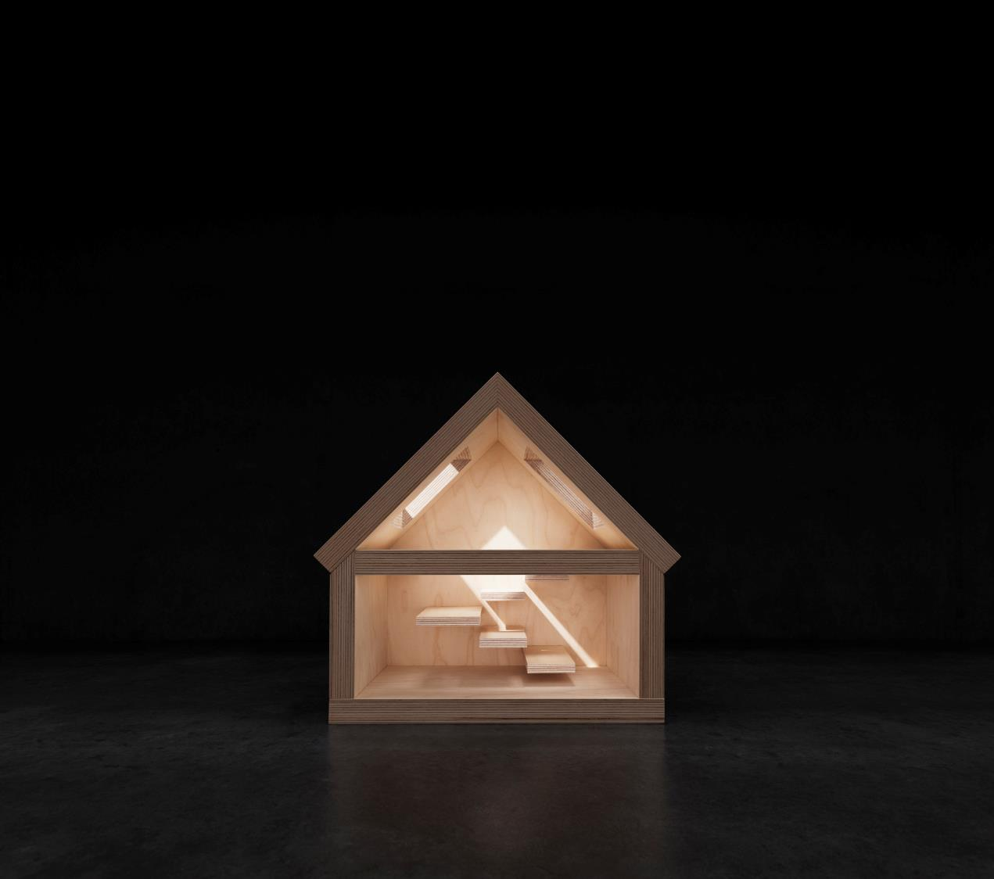

FENOMÉN SCHODIŠŤOVÉ ŠACHTY
Notes:
Daylight to every room and floor
The internal distribution of rooms and passages may limit the availability of daylight, especially if the building is older and includes a plan design that ranks the separation of functional areas into smaller spaces. In these cases it can be beneficial to rethink the areas where rooms or corridors connect one part of the home to another. The connecting space can act as a vehicle for distributing daylight to a larger part of the home.
Grafic: A stairwell can act as the perfect light distributor, feeding natural lighting to several floors and adjoining rooms. Windows can be placed above and alongside the staircase for maximum effect.

Slide 29
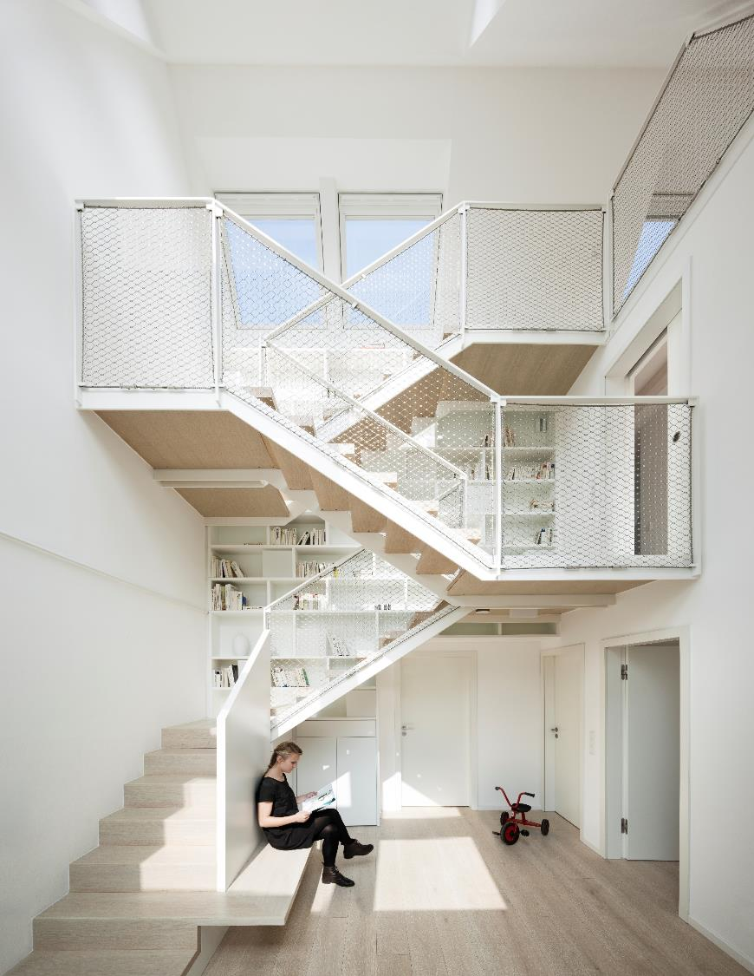
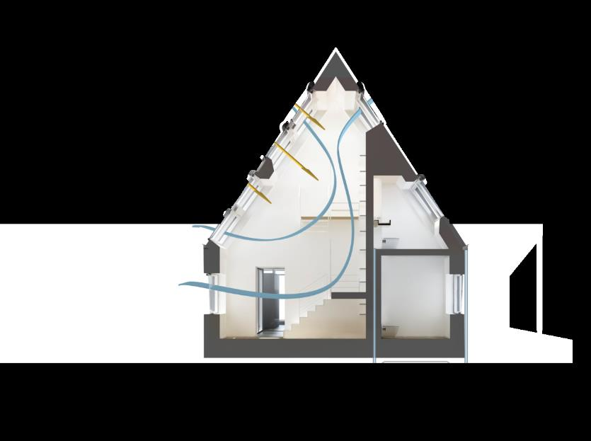

Schodišťovou šachtou je ventilace nejefektivnější
Prosvětlení přízemí
Notes:
Openings on several floors will boost the ventilation process. Combining cross ventilation with the stack effect can lead to airings up to 6.5 air changes per hour (ACH).
Night cooling saves energy and improves thermal comfort due to the free cooling effect that occurs when cool night air cools down the thermal mass.

Slide 30
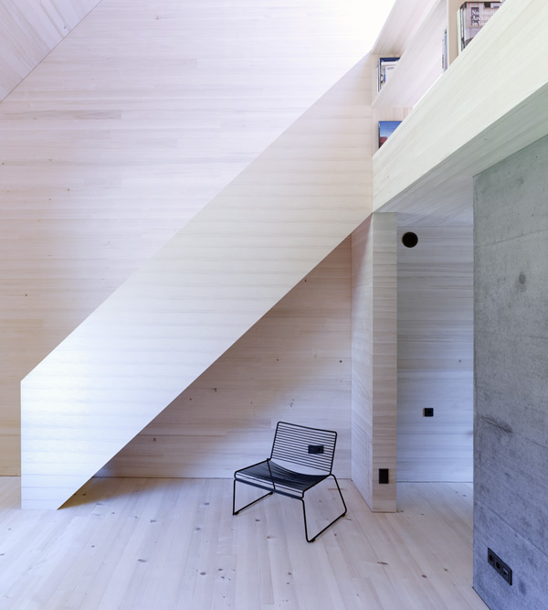

Slide 31
THERMAL CONTROL
BY AIRING
Notes:
Sound asleep
It can be quite a challenge to keep all the necessary requirements for an ideal sleeping environment in balance all year round. Lighting, air quality and energy consumption all need to be controlled to ensure the best possible conditions in the bedroom. The following are three ways of tackling the different issues related to controlling the environment summer and winter.
Grafic: Night cooling uses cool outdoor air to cool down a building’s thermal
mass. The next day less cooling is needed to cool the building, as the thermal mass has already been cooled down.

Slide 32


SOLÁRNÍ ZISKY V ZIMĚ
Notes:
A warm welcome to the g-value
Sunrays are turned into heat when they pass through the windowpane and hit the interior. The effect improves as the window is raised from a 90˚ angle toward a pitch, matching the incoming light from the sun. Heat transmittance in terms of heat loss admittedly increases with a more horizontal window pitch, but the passive solar gain increases even more, improving the g-value to create an overall positive energy balance.
The free heating is welcome as a supplement to the home’s mechanical heating system, but it needs to be controlled to avoid unpleasant temperatures.
Grafic: Windows facing south produce free heating all year long; however, only roof windows offer a positive energy balance. Solar gain should be evaluated before final specification, e.g. using the VELUX Energy and Indoor Climate Visualizer.

Slide 33
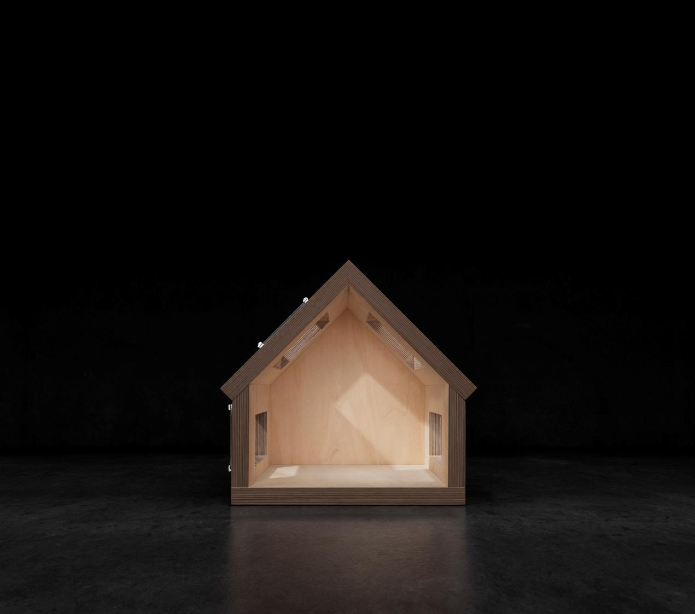

VENKOVNÍ STÍNĚNÍ V LÉTĚ
Notes:
Grafic: Awning blinds reduce the heating effect by up to 73% and roller shutters by up to 90%. North-facing windows maintain optimal daylight conditions inside the room. Daylight, regardless of solar protection, reduces the need for artificial lighting.

Slide 34
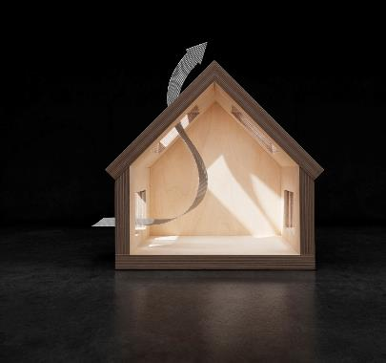
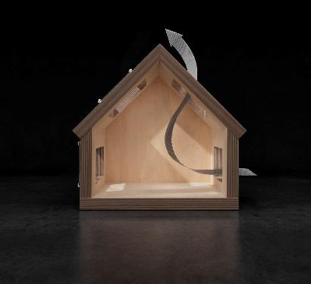
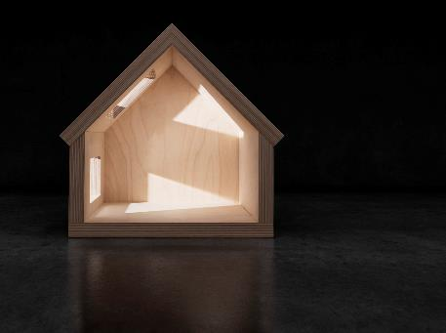
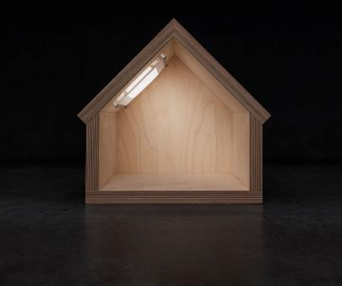
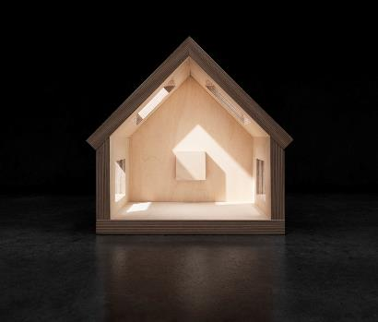
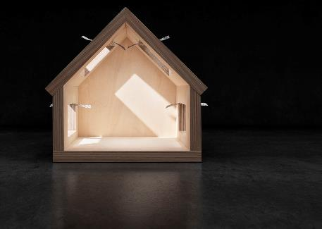
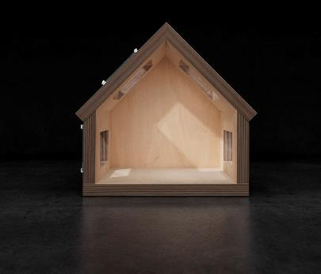


KOMFORT DÍKY CHYTRÉ AUTOMATIZACI
Notes:
Sensor-driven operation supported by network data optimises ventilation and thermal control
Automation keeps the home in good shape
To create and maintain a comfortable and healthy indoor environment is not an easy undertaking. It takes a lot of effort to manage a dynamic climate envelope, continuously adjusting it according to season and the time of the day.
The sizable task makes it all the more opportune to choose a fully automated solution that ensures optimal operation day and night.
VELUX ACTIVE
One of the most intelligent automation systems currently available is VELUX ACTIVE with NETATMO, which carefully operates each product proactively based on data from home sensors and external sources. The system reacts when there is a change in temperature or air quality. It can even react in advance, as the system continuously upgrades its algorithms based on previous sensor readings as well as information obtained from e.g. the NETATMO weather information system.
The VELUX ACTIVE sensor is able to monitor CO2, humidity and temperature. The moment one of these exceeds the maximum level for a healthy indoor climate, the system operates the windows to readjust the levels.
• VELUX ACTIVE keeps an eye on how recently the windows have been opened. After 2-6 hours, the system will try to perform a ventilation process, depending on the current and imminent weather situation.
• If the weather services predict warm weather, VELUX ACTIVE will react by operating awning blinds or roller shutters to counteract solar heating. The system will only react if it knows shading will have a significant effect. Historical data will help to improve the system algorithm and its ability to forecast when shading is required.

